Slide 1
Comparing several means: ANOVA (GLM 1)
Chapter 10

Slide 2
When And Why
When we want to compare means we can use a t-test. This test has limitations:
You can compare only 2 means: often we would like to compare means from 3 or more groups.
It can be used only with one Predictor/Independent Variable.

Slide 3
When And Why
ANOVA
Compares several means.
Can be used when you have manipulated more than one Independent Variables.
It is an extension of regression (the General Linear Model).

Slide 4
Why Not Use Lots of t-Tests?
If we want to compare several means why don’t we compare pairs of means with t-tests?
Can’t look at several independent variables.
Inflates the Type I error rate.
1
1
2
Vs
1
3
Vs
2
3
2
Vs
3

Slide 5
Type 1 error rate
Formula = 1 – (1-alpha)^{c}
Alpha = type 1 error rate = .05 usually (that’s why the last slide had .95)
C = number of comparisons
Familywise = across a set tests for one hypothesis
Experimentwise = across the entire experiment

Slide 6
Regression v ANOVA
ANOVA in Regression:
Used to assess whether the regression model is good at predicting an outcome.
ANOVA in Experiments:
Used to see whether experimental manipulations lead to differences in performance on an outcome (DV).
By manipulating a predictor variable can we cause (and therefore predict) a change in behavior?
Actually can be the same question!

Slide 7
What Does ANOVA Tell us?
Null Hyothesis:
Like a t-test, ANOVA tests the null hypothesis that the means are the same.
Experimental Hypothesis:
The means differ.
ANOVA is an Omnibus test
It test for an overall difference between groups.
It tells us that the group means are different.
It doesn’t tell us exactly which means differ.

Slide 8
Theory of ANOVA
We compare the amount of variability explained by the Model (experiment), to the error in the model (individual differences)
This ratio is called the F-ratio.
If the model explains a lot more variability than it can’t explain, then the experimental manipulation has had a significant effect on the outcome (DV).

Slide 9
F-ratio
Variance created by our manipulation (IV levels)
Good variance (systematic variance)
Variance created by unknown factors
Bad variance (unsystematic variance)
Drawing here.
F-ratio = systematic / unsystematic
But now these formulas are more complicated

Slide 10
Theory of ANOVA
We calculate how much variability there is between scores
Total Sum of squares (SS_{T}).
We then calculate how much of this variability can be explained by the model we fit to the data
How much variability is due to the experimental manipulation, Model Sum of Squares (SS_{M})...
… and how much cannot be explained
How much variability is due to individual differences in performance, Residual Sum of Squares (SS_{R}).

Slide 11
Theory of ANOVA
If the experiment is successful, then the model will explain more variance than it can’t
SS_{M} will be greater than SS_{R}
(however, we actually compare MS).

Slide 12
ANOVA Example
Testing the effects of Viagra on Libido using three groups:
Placebo (Sugar Pill)
Low Dose Viagra
High Dose Viagra
The Outcome/Dependent Variable (DV) was an objective measure of Libido.

Slide 13
The Data

Slide 14
Step 1: Calculate SS_{T}

Slide 15
Total Sum of Squares (SS_{T}):
Grand Mean

Slide 16
Degrees of Freedom (df)
Degrees of Freedom (df) are the number of values that are free to vary.
In general, the df are one less than the number of values used to calculate the SS.

Slide 17
Step 2: Calculate SS_{M}

Slide 18
Model Sum of Squares (SS_{M}):
Grand Mean

Slide 19
Model Degrees of Freedom
How many values did we use to calculate SS_{M}?
We used the 3 means (levels).

Slide 20
Step 3: Calculate SS_{R}

Slide 21
Residual Sum of Squares (SS_{R}):
Grand Mean
Df = 4
Df = 4
Df = 4

Slide 22
Step 3: Calculate SS_{R}

Slide 23
Residual Degrees of Freedom
How many values did we use to calculate SS_{R}?
We used the 5 scores for each of the SS for each group.

Slide 24
Double Check

Slide 25
Step 4: Calculate the Mean Squared Error

Slide 26
Step 5: Calculate the F-Ratio

Slide 27
Step 6: Construct a Summary Table
Source | SS | df | MS | F
Model | 20.14 | 2 | 10.067 | 5.12*
Residual | 23.60 | 12 | 1.967
Total | 43.74 | 14

Slide 28
F-tables
Now we’ve got two sets of degrees of freedom
DF model (treatment)
DF residual (error)

Slide 29
F-values
Since all these formulas are based on variances, F values are never negative.
Think about the logic (model / error)
If your values are small you are saying model = error = just a bunch of noise because people are different
If your values are large then model > error, which means you are finding an effect.

Slide 30
Assumptions
Data screening: accuracy, missing, outliers
Normality
Linearity (it is called the general linear model!)
Homogeneity – Levene’s (new!)
Homoscedasticity (still a form of regression)
So you can do the normal screening we’ve already done and add Levene’s test.

Slide 31
Assumptions
ANOVA is often called a “robust test”
What? Robustness = ability to still give you accurate results even though the assumptions are bent.
Yes mostly:
When groups are equal
When sample sizes are sufficiently large

Slide 32
Assumptions
Levene’s Test
Levene’s test is an ANOVA using variances as a testing point, instead of the means.
Tells you if variances are equal across groups.
You DO NOT want this test to be significant, but remember the big important rule, p < .001 is bad.

Slide 33
Run the ANOVA!
We are going to use the ezANOVA function in the ez library.
The advantage of ez anova:
Runs Levene’s test for you.
Gives you an effect size, along with the ANOVA.

Slide 34
Run the ANOVA!
First, you must add a participant number if you do not already have one in the dataset.
It is advantageous to wait to add one until the end of data screening (or you would need to drop that column for every assumption test).
dataset$partno = 1:nrow(dataset)
Also make sure the IV is factored, or it will not give you Levene’s test.

Slide 35
Run the ANOVA!
Run an ezANOVA!
ezANOVA(
data = dataset,
dv = dv column,
between = iv column,
wid = partno,
type = 3,
detailed = T)

Slide 36
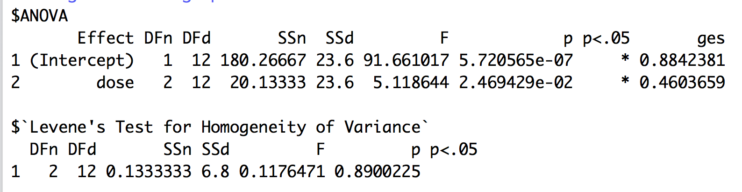
Get the output!
You will get a warning – just ignore it.
“Warning converting partno to a factor for ANOVA”.
Levene’s test is not significant, F(2,12) = 0.12, p = .89

Slide 37
Run the ANOVA!
What do you do if homogeneity test was significant? (Levene’s)
Run a Welch correction on the ANOVA using the oneway function.
oneway.test(Y ~ X, data = data)

Slide 38
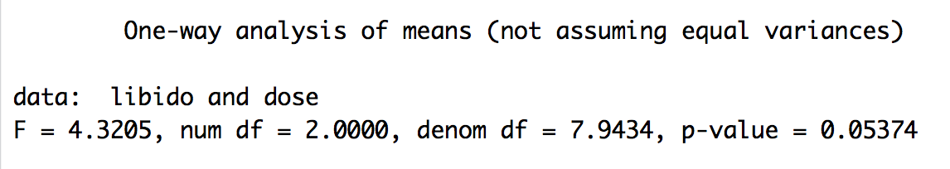
Run the ANOVA!

Slide 39
APA – just F-test part
There was a significant effect of Viagra on levels of libido, F(2, 12) = 5.12, p = .03, η²= .46.
We will talk about Means, SD/SE as part of the post hoc test.
Remember, you can turn off scientific notation with options(scipen = 999)

Slide 40
Effect size for the ANOVA
In ANOVA, there are two effect sizes – one for the overall (omnibus) test and one for the follow up tests (coming next).
Let’s talk about the overall test:
F-test
R²
η² - (ges²)
ω²

Slide 41
Effect size for the ANOVA
Proportion of variability accounted for by an effect
Useful when you have more than two means, gives you the total good variance with 3+ means
Can only be positive
Range from .00 – 1.00
Small = .01, medium = .06, large = .15

Slide 42
Effect size for the ANOVA
R² – more traditionally listed with regression
ɳ² – more traditionally listed with ANOVA
SSModel/SStotal
Remember total = model + residuals
20.13+23.6
[1] 43.73
20.13/43.73
[1] 0.4603247

Slide 43
Effect size for the ANOVA
ω²
R² and η² tend to overestimate effect size
Omega squared is an R² style effect size (variance accounted for) that estimates effect size on population parameters
SSM – (dfM)*MSR
SStotal + MSR

Slide 44
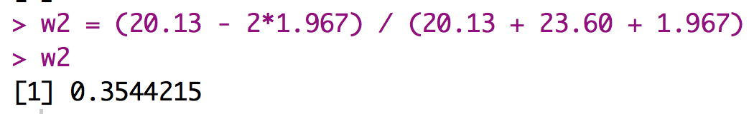
Effect size for the ANOVA

Slide 45
Post Hocs and Trends

Slide 46
Why Use Follow-Up Tests?
The F-ratio tells us only that the experiment was successful
i.e. group means were different
It does not tell us specifically which group means differ from which.
We need additional tests to find out where the group differences lie.

Slide 47
How?
Multiple t-tests
We saw earlier that this path is a bad idea
Orthogonal Contrasts/Comparisons
Hypothesis driven
Planned a priori
Post Hoc Tests
Not Planned (a posteriori)
Compare all pairs of means
Trend Analysis

Slide 48
Post Hoc Tests
Compare each mean against all others.
In general terms they use a stricter criterion to accept an effect as significant.
TEST = t.test or F.test
CORRECTION = None, Bonferroni(*), Tukey, SNK, Scheffe

Slide 49
Post Hoc Tests
For all of these post hocs, we are going to use t-test to calculate the if the differences between means is significant.
We are going to run the Bonferroni and compare to no correction to talk about how these corrections work.

Slide 50
Post Hoc Tests - Bonferroni
Restricted sets of contrasts – these tests are better with smaller families of hypotheses (i.e. less comparisons over they get overly strict).
These tests adjust the required p value needed for significance.
Bonferroni – through some fancy math, we’ve shown that the family wise error rate is < number of comparisons times alpha.
⍺ < c*⍺

Slide 51
Post Hoc Tests - Bonferroni
Therefore it’s easy to correct for the problem by dividing alpha by c to control where alpha = ⍺ / c
However, Bonferroni will over correct for large number of tests
Other types of restricted contrasts:
Sidak-Bonferroni
Dunnett’s test

Slide 52
Post Hoc Tests - Bonferroni
pairwise.t.test(DV column,
IV column,
p.adjust.method = "bonferroni”,
paired = F,
var.equal = T)

Slide 53
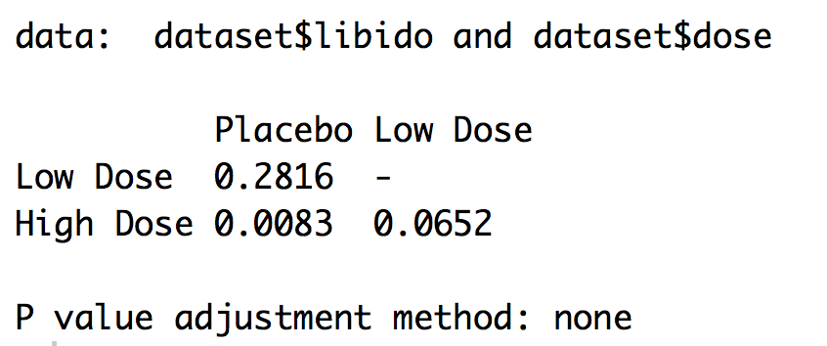
Post Hoc Tests - Comparison
Group 1 | Group 2 | No Correction | Bonferroni | d
Placebo | Low Dose | .28
Placebo | High Dose | .008
Low Dose | High Dose | .07

Slide 54
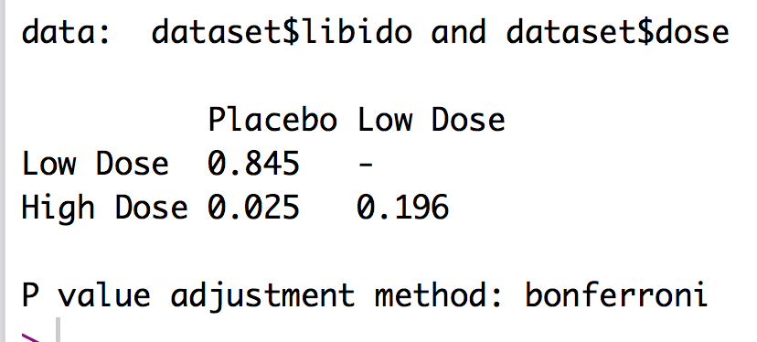
Post Hoc Tests - Comparison
Group 1 | Group 2 | No Correction | Bonferroni | d
Placebo | Low Dose | .28 | .85
Placebo | High Dose | .008 | .03
Low Dose | High Dose | .07 | .20

Slide 55
Effect Size for Post Hocs
Because we have calculated every pairwise combination, we can use d to calculate the effect sizes for each combination.
Use MOTE for independent t, d_{s}

Slide 56
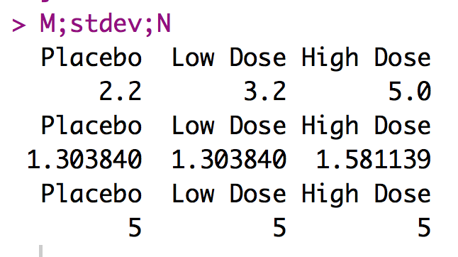
Post Hoc Tests – Effect Size
Group 1 | Group 2 | No Correction | Bonferroni | d
Placebo | Low Dose | .28 | .85 | 0.77
Placebo | High Dose | .008 | .03 | 1.94
Low Dose | High Dose | .07 | .20 | 1.24

Slide 57
Reporting Results
There was a significant effect of Viagra on libido, F(2, 12) = 5.12, p = .03, η²= .46. Post hoc independent t tests with a Bonferroni correction were used to find differences in levels of Viagra. The placebo group was not significantly different from low dose group (p = .85, d = 0.77), but was significantly different from from the high dose group (p = .03, d = 1.94). The low dose and high dose group were not significantly different (p = .20, d 1.24).
Include a figure of the means! OR list the means in the paragraph.

Slide 58
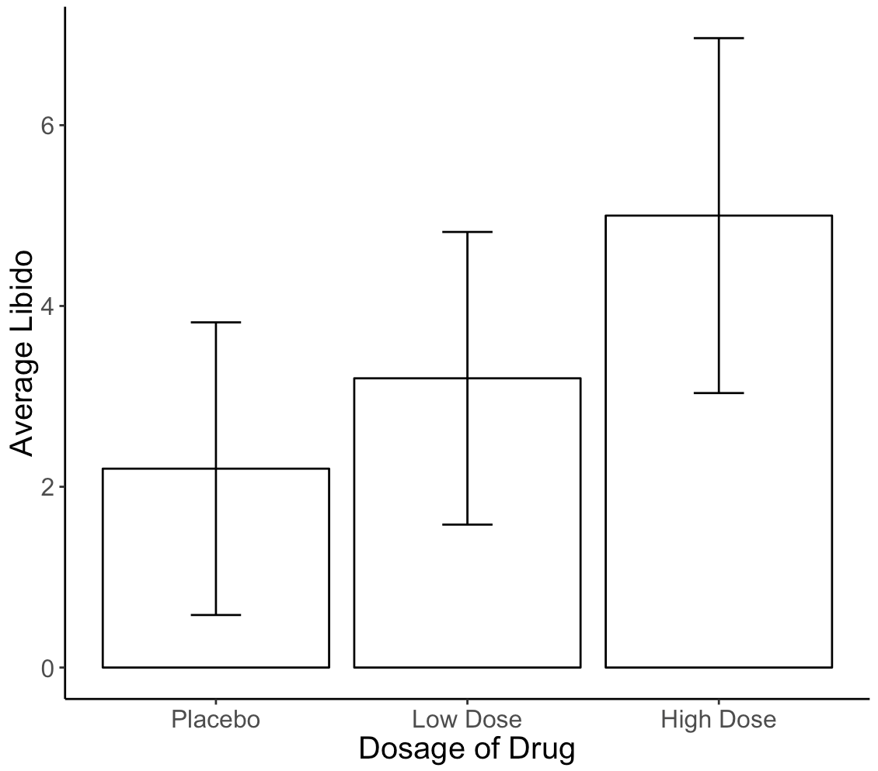

Slide 59
Trend Analysis

Slide 60
Trend Analyses
Quadratic Trend = a curve across levels
Cubic Trend = two changes in direction of trend
Quartic Trend = three changes in direction of trend

Slide 61
Trend Analysis in R
First, we have to set up the data:
k = 3 ##set to the number of groups
contrasts(IV column) = contr.poly(k)
##note this does change the original dataset

Slide 62
Trend Analysis in R
Then run an ANOVA – coded as a lm():
This code is what the book suggests for all ANOVAs, but ezANOVA is much easier.
output = aov(DV ~ IV, data = dataset)
summary.lm(output)

Slide 63
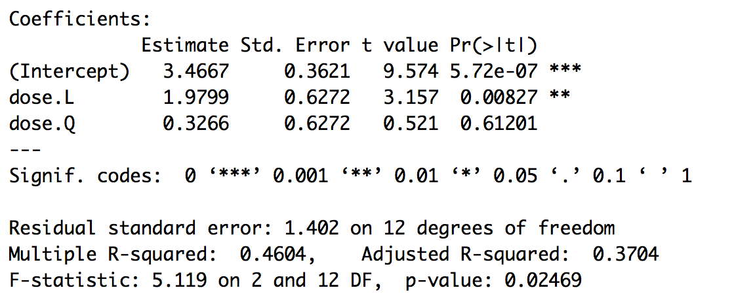
Trend Analysis in R

Slide 64
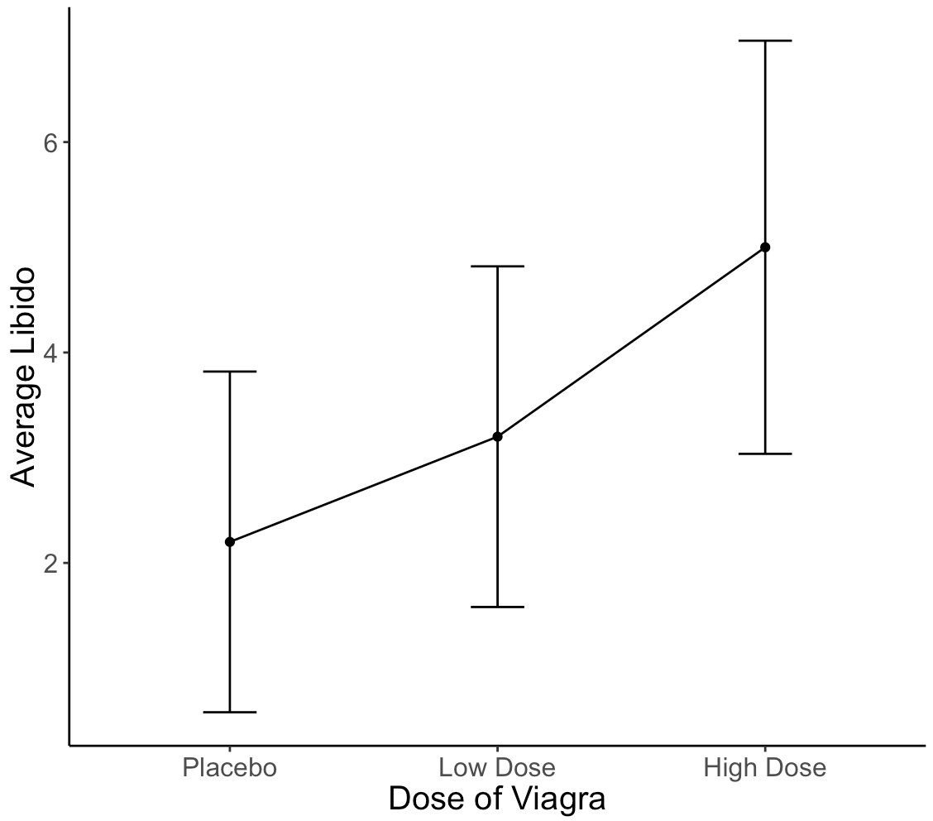

Slide 65
Reporting Results
There was a significant linear trend, t(12) = 3.157, p = .008, R² = .46, indicating that as the dose of Viagra increased, libido increased as well.
(Include line graph).

Slide 66
Power – One Way Between Subjects
pwr.anova.test(k = number of levels for the IV,
n = NULL,
f = convert eta squared,
sig.level = .05,
power = .80)
To convert:

